Slide 1
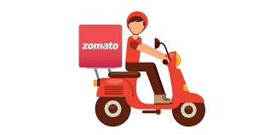
ZOMATO ANALYSIS
Group – 2
Amarja Aniket Joshi
Shek Hyder Ali
Amrutha M S

Slide 2
Business Challenges:
Intense Competition: The market is highly competitive, with competitors offering attractive features that resonate well with customers.
Customer Confusion: Ensuring clarity between Zomato and the restaurants is crucial to providing a seamless customer experience.
Competitor Monitoring: There is a constant need to monitor competitors to stay ahead in the market
Brand Reputation: Any mishap, whether from restaurants or delivery services, can significantly impact Zomato's brand image
Scope:
Revenue Streams: Zomato generates revenue through advertising, online table reservations, and meal ordering and delivery, which present significant growth opportunities,
Market Potential: Given the current demand and future prospects, launching a food delivery business using a Zomato Clone can be a strategic move.

Slide 3
KPI- YEARWISE RESTAURANTS COUNT
Analysis:
The count of restaurants from 2012 to 2016 showed a decline compared to other years.
It could be attributed to various factors, including market saturation, economic conditions, and competition.
Conduct in-depth analysis to identify specific reasons for the decline in restaurant counts during 2012-2016, considering all these factors and use insights to develop targeted strategies for revitalizing restaurant growth, such as exploring untapped markets, adapting to economic changes, and differentiating from competitors.

Slide 4
KPI- MONTHWISE RESTAURANTS COUNT
Analysis:
March and September have the highest number of restaurants with 838 each and February has the lowest number of restaurants with 745.
Higher restaurant counts in March and September may be due to factors like favorable weather, holidays, and cultural events, encouraging more dining out. February's lower counts could be influenced by colder weather and reduced consumer spending post-holiday season.
Further analyze weather data, local events, and consumer behavior to understand drivers behind March and September peaks. Investigate historical data and consumer surveys to identify strategies for attracting more customers in February.

Slide 5
KPI- RESTAURANTS BASED ON HAS ONLINE DELIVERY
Analysis:
74.34% of restaurants in the dataset do not offer online delivery, while 25.66% do offer this service indicates that a majority of restaurants do not offer online delivery.
This highlights a missed opportunity for many restaurants to connect with customers through online delivery, potentially limiting their reach and growth.
Restaurants could enhance their customer reach by considering the online delivery services, aligning with evolving consumer preferences for convenience and accessibility. This can help restaurants stay competitive, attract new customers, and increase revenue.
KPI- RESTAURANTS BASED ON HAS TABLE BOOKING
Analysis:
87.88% of restaurants in the dataset do not offer table booking, while 12.12% offer this service indicates a strong preference for spontaneous dining or quick-service options
Restaurants can cater to this preference by focusing on providing quick and efficient service to attract more customers ,Offering special deals or rewards for walk-in customers could also help create a more inviting atmosphere and increase customer loyalty.

Slide 6
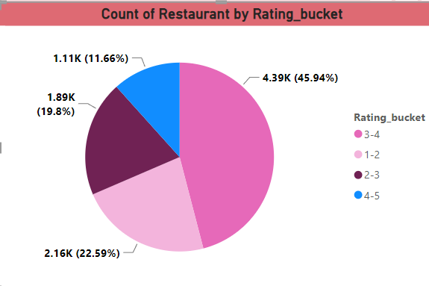
KPI- RATING VS RESTAURANT COUNT
Analysis:
Most restaurants (4388) fall within the 3-4 rating range, indicating above-average to good ratings. Fewer restaurants have ratings in the extremes, suggesting that achieving very low or very high ratings is less common.
This could be by various factors such as the quality of food and service, pricing, ambiance, and customer preferences.
Restaurants with lower ratings should focus on improving quality and service, while those with higher ratings should maintain their standards to retain customers.

Slide 7
KPI- SALES BUCKET VS RESTAURANT COUNT
Analysis:
Majority of restaurants (3646) fall within the 301-600 sales bucket, with a relatively even distribution across the other ranges.
Influenced by several factors such as the size and type of the restaurant, its location, pricing strategy, menu offerings, and overall customer appeal.
Restaurants in lower sales buckets could explore strategies to increase sales, such as offering promotions, improving marketing efforts, or enhancing the customer experience.
Restaurants in higher sales buckets should focus on maintaining their sales levels and continuing to provide high-quality products and services to retain customers.

Slide 8
CONCLUSION:
The restaurant industry is diverse, with restaurants varying in ratings, sales performance, and services offered.
Understanding seasonal trends and customer preferences, such as the popularity of online delivery, can help restaurants tailor their offerings to better meet customer needs.
To succeed in this competitive landscape, restaurants should focus on providing quality food and service, while also considering innovative marketing strategies to attract and retain customers.
By leveraging data and insights, restaurants can make informed decisions that drive growth and ensure long-term success in the ever-evolving restaurant industry.

Slide 9
THANK YOU

